Slide 1
MLOps Kick-off
What The Hack?!

Slide 2
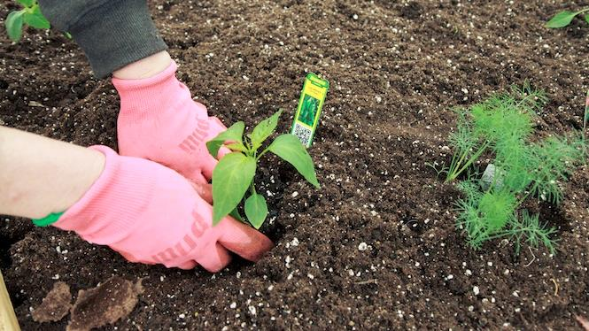
You will get your hands dirty

Slide 3
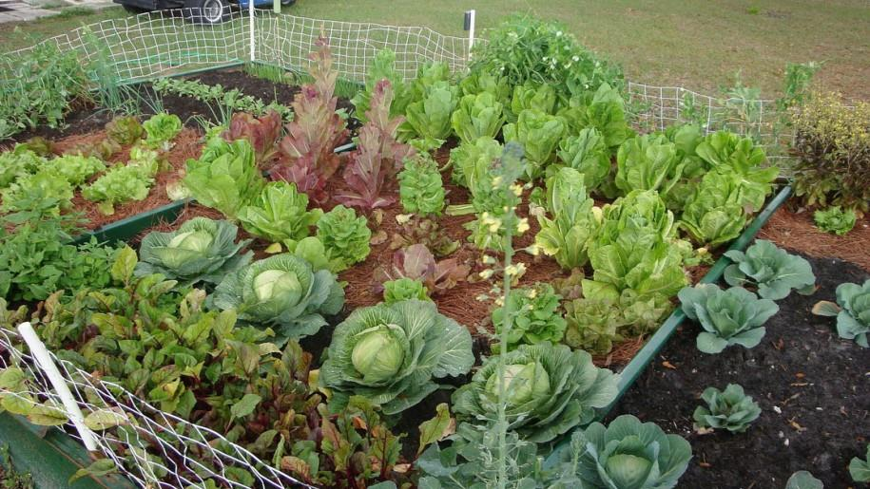
*results may vary

Slide 4
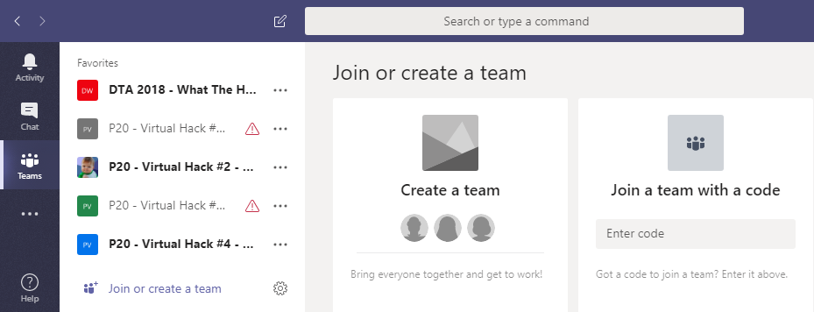
Collaboration
Step 1: Join the Team!
#2
#1
-- join code --

Slide 5
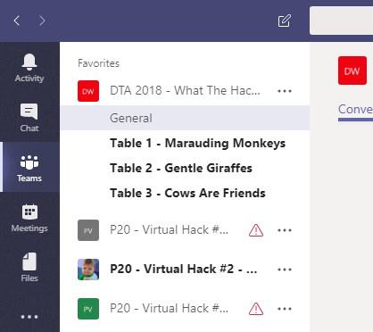
Collaboration
Step 2: Create a Channel for your table’s team!
Name your team something unique and fun, but prefix with your table #!

Slide 6
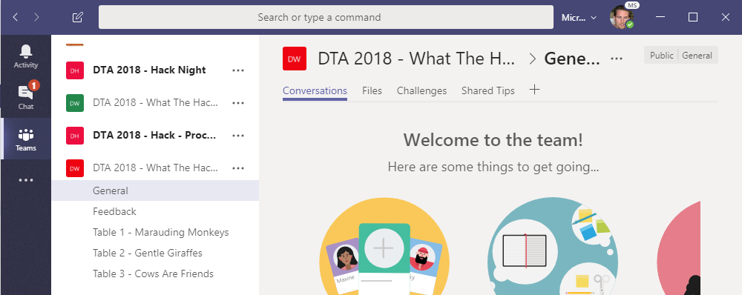
Collaboration
Step 3: Collaborate!
Hang out, communicate, talk, and screenshare with squad members in your squad’s channel
DURING & after the event, share feedback with the proctors in the Feedback channel. This will help them improve the event as it progresses and make the next one even better
Find any files, resources, or code samples, and THIS presentation here!
Challenges will be posted here by the proctors throughout the event
Share tips, tricks, gotchas (how you solved them), code snippets, and links you learn along the way here with everyone

Slide 7
Format
Challenges are cumulative, building upon each other.
Establish Confidence – start small and simple (think hello world)
Build Competence – by having successively more complex challenges
Challenges are NOT step-by-step hands on labs!
No “clicking here” or “copy n pasting there”
Challenge definitions are short. A couple of sentences or bullet points stating the end goal(s) and perhaps a hint at the skill(s) needed.
You MUST work together as a team to figure out how to complete them!

Slide 8
Format
For each challenge we will deliver a ”mini-lecture” explaining concepts in it.
We’ll review results for each challenge when it looks like a majority of folks have completed the challenge
Don’t be beholden by the clock!
Move quickly or take it slow.
Your proctors are here to help you.
There WILL be more challenges than you can complete in our allotted time!
These are takeaways for follow up at home or with customers!

Slide 9
Proctors
Each team will have a proctor through-out the whole hack.
Use them! But don’t expect them to give you all the answers.
Get to know your proctor, their likes and dislikes...
All the better to find a bribe that works!

Slide 10
Tooling
You can use any tooling you want, but we strongly encourage (and will only support the following):
-- insert your list of required tooling here --
-- Eg: Visual Studio Code
-- Eg: Windows Subsystem for Linux with the Azure CLI installed.

Slide 11
Finding Answers
Search engines are your friend! Azure is a hot technology and much ink has been spilled on it.
The Azure docs are your best bet.
Many of the related open source projects used here have top notch documentation!

Slide 12

And now death by Power Point…

Slide 13
Machine Learning is now where Software Engineering was 15 years ago

Slide 14

But ML is hard!

Slide 15
Building a model
Notes:
7 – 8 minutes

Slide 16
Discuss how ’Buidling a model is only one part of the whole process
Data ingestion
Data analysis
Data transformation
Data validation
Data splitting
Trainer
Building a model
Model validation
Training at scale
Roll-out
Serving
Monitoring
Logging
Notes:
8-10 minutes

Slide 17
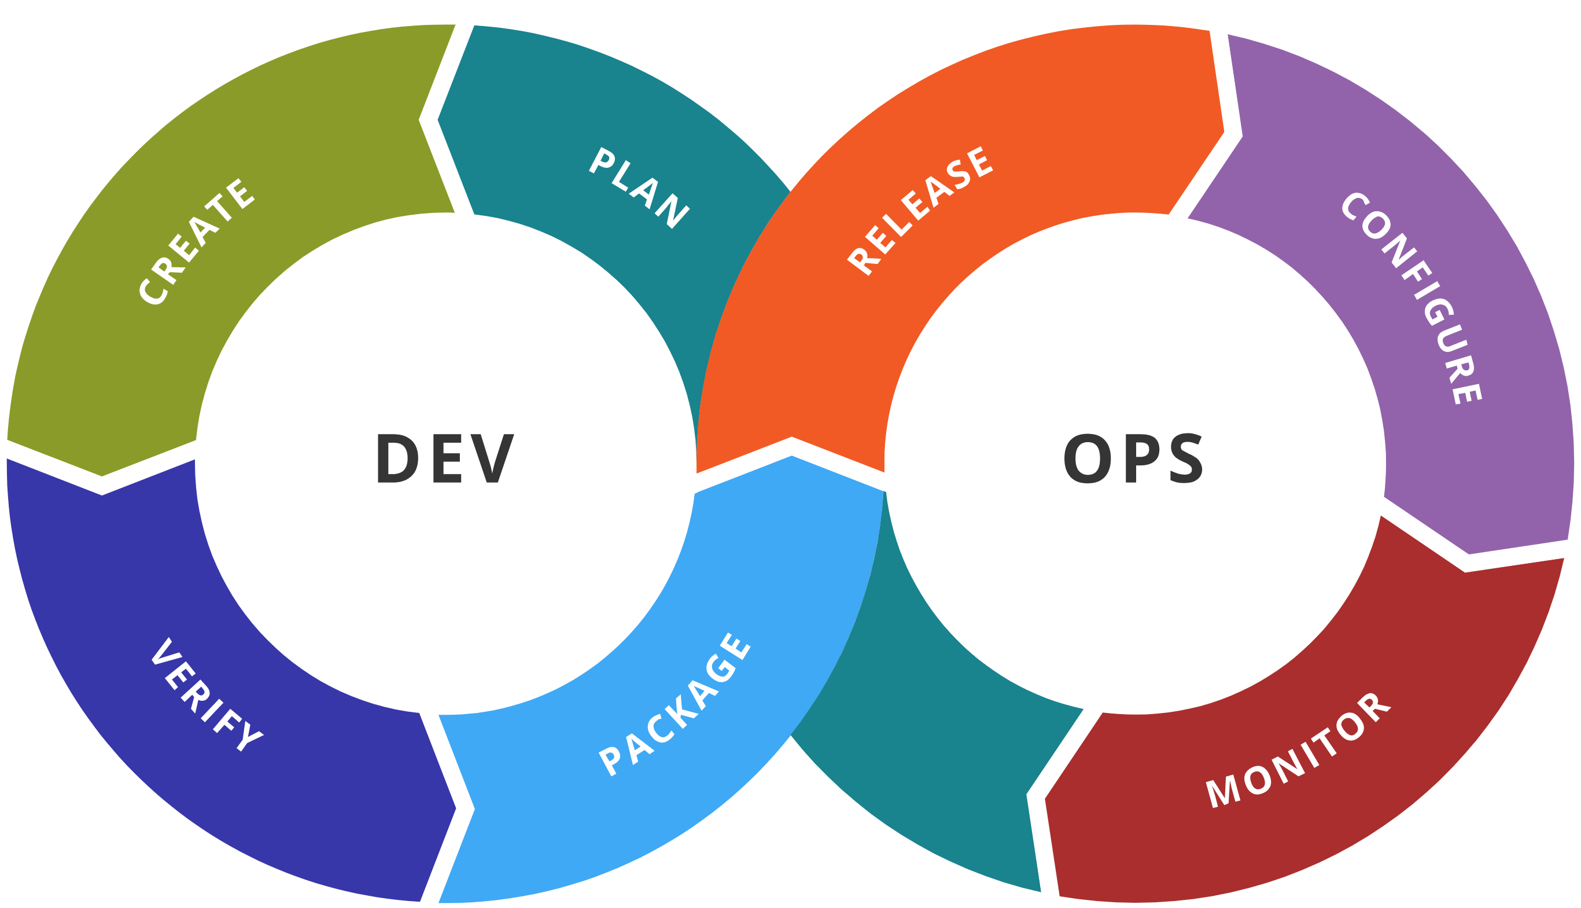
ML Lifecycle
Experiment
Experiment
Data Acquisition
Business Understanding
Initial Modeling
Develop
Modeling
Operate
Continuous Delivery
Data Feedback Loop
System + Model Monitoring
+ Testing
Continuous Integration
Continuous Deployment

Slide 18
Ok, but, like, I’m a data scientist.
I don’t care about all that.
Notes:
10 minutes

Slide 19
Yes, You Should!
Notes:
10 minutes

Slide 20
MLOps!

Slide 21
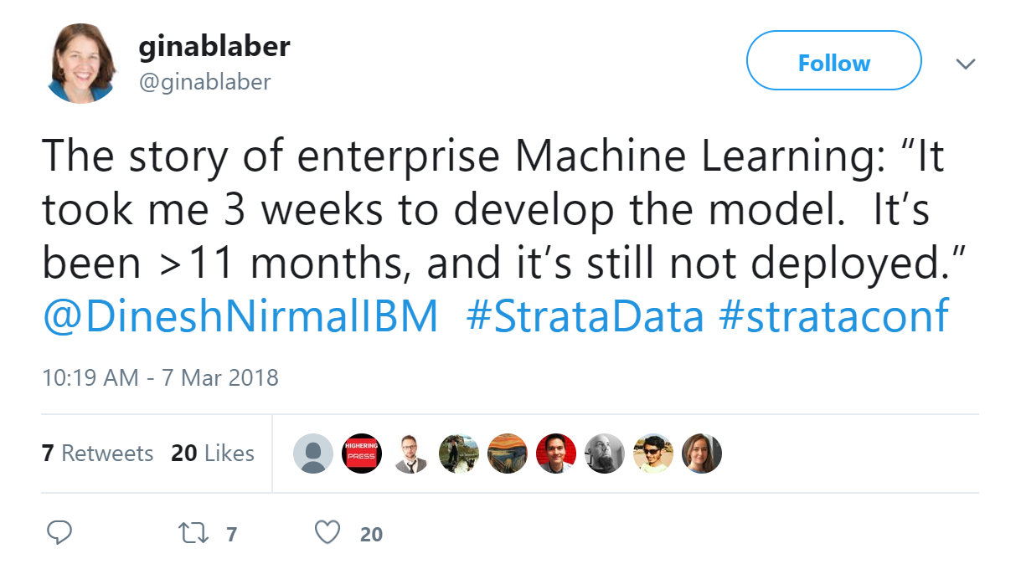
Notes:
Look up who is Dinesh Nirmal IBM

Slide 22



Cowboys and Ranchers Can Be Friends!
Data Scientist
SRE/ML Engineers
Quick iteration
Frameworks they understand
Best of breed tools
No management headaches
Unlimited scale
Reuse of tooling and platforms
Corporate compliance
Observability
Uptime
Notes:
Site Reliability Engineers

Slide 23
Enter MLOps

Slide 24
MLOps Benefits
Reproducibility / Auditability
Validation
Automation / Observability
Code drives generation and deployments
Pipelines are reproducible and validatable
All artifacts can be tagged and audited
SWE best practices for unit testing, source data analysis, profiling
Offline comparisons of model quality
Minimize bias and enable explainability
Controlled rollout capabilities & tracking across cloud/edge
Live comparison of predicted vs. expected performance
Results fed back to watch for drift and improve model

Slide 25


MLOps Workflow
Collaborate
Build app
Test app
Release app
Monitor app
App developer
using Azure DevOps
Data scientist using
Azure Machine Learning
Model reproducibility
Model validation
Model deployment
Model retraining

Slide 26


MLOps Workflow
Collaborate
Build app
Test app
Release app
Monitor app
App developer
using Azure DevOps
Code, dataset, and environment versioning
Data scientist using
Azure Machine Learning
Model reproducibility
Model validation
Model deployment
Model retraining

Slide 27
MLOps Workflow
Collaborate
Build app
Test app
Release app
Monitor app
App developer
using Azure DevOps
Train model
Automated ML
ML Pipelines
Hyperparameter tuning
Data scientist using
Azure Machine Learning
Model reproducibility
Model validation
Model deployment
Model retraining

Slide 28
MLOps Workflow
Collaborate
Build app
Test app
Release app
Monitor app
App developer
using Azure DevOps
Train model
Validate model
Model validation & certification
Data scientist using
Azure Machine Learning
Model reproducibility
Model validation
Model deployment
Model retraining

Slide 29

MLOps Workflow
Collaborate
Build app
Test app
Release app
Monitor app
App developer
using Azure DevOps
Train model
Validate model
Deploy model
Model packaging
Simple deployment
Data scientist using
Azure Machine Learning
Model reproducibility
Model validation
Model deployment
Model retraining

Slide 30
MLOps Workflow
Collaborate
Build app
Test app
Release app
Monitor app
App developer
using Azure DevOps
Train model
Validate model
Deploy model
Monitor model
Model management & monitoring
Data scientist using
Azure Machine Learning
Retrain model
Model performance analysis
Model reproducibility
Model validation
Model deployment
Model retraining

Slide 31

MLOps Workflow
Collaborate
Build app
Test app
Release app
Monitor app
App developer
using Azure DevOps
Train model
Validate model
Deploy model
Monitor model
Model management & monitoring
Data scientist using
Azure Machine Learning
Retrain model
Model performance analysis
Model reproducibility
Model validation
Model deployment
Model retraining

Slide 32
MLOps on Azure

Slide 33
Azure Services Supporting MLOps
Fast, easy to use, well-controlled MLOps lifecycle
Infrastructure as Code
CI/CD
Testing / Release / Monitoring
Azure Resource Manager Templates
Azure ML Python SDK & CLI
Azure SDK’s
Azure DevOps Pipelines
Azure ML Training Services
Azure Repos / GitHub
Azure Boards
Azure DevOps for automated testing
R - Runit and testthat
Python - PyUnit, pytest, nose, …
Azure ML & MLFlow Tracking
Azure Data Prep SDK (analyse/profile)
Azure ML Model Management (Instrumentation, Telemetry)
Azure Monitor for app telemetry

Slide 34
New MLOps Services from Azure Machine Learning

Slide 35
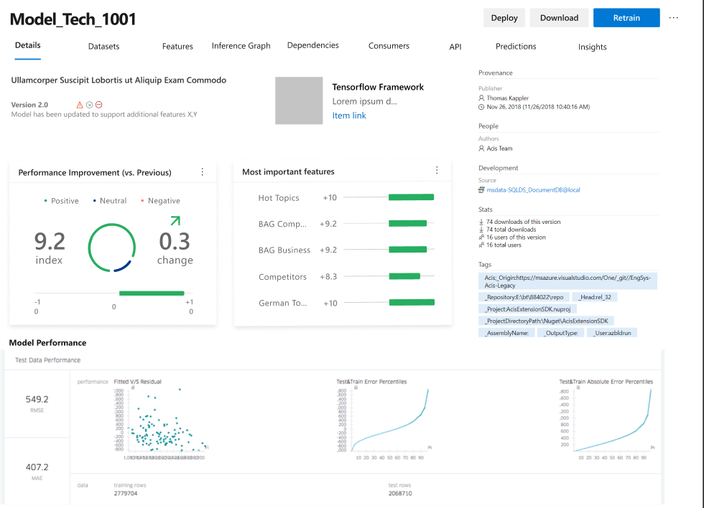
Model Versioning & Storage
Provide a consistent way to discover, store, track & share models
Provide a consistent model metadata format
Track where a model came from
which data,
which experiment / previous model(s),
where’s the code / notebook)
Was it converted / quantized?
Track where model is running & model health
Control who has access to what models
Private / compliant data

Slide 36
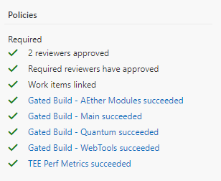
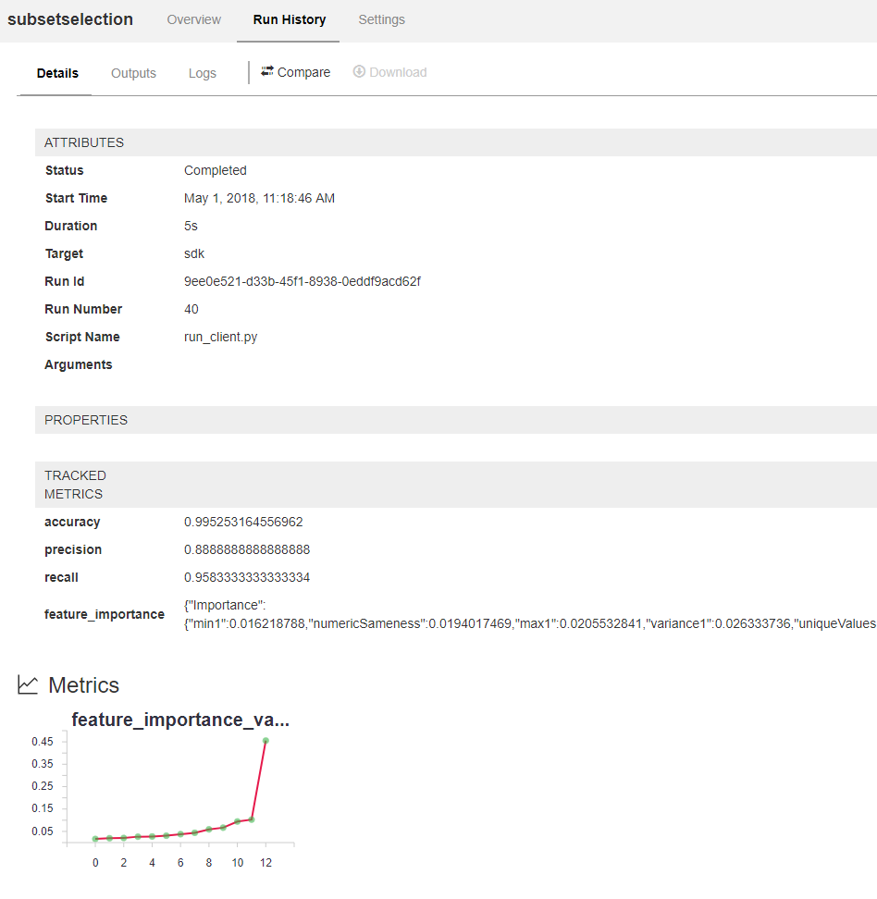
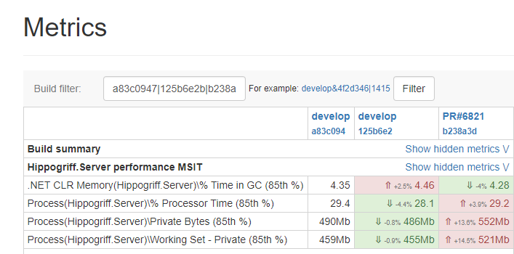
Model Validation
Profile and validate
Data (changes to shape / profile)
Model in isolation (offline A/B)
Model + app (functional testing)
Control model rollout on validation
Only deploy after initial validation passes
Ramp up traffic to new model using A/B experimentations
Assess performance
Functional behavior
Performance characteristics

Slide 37
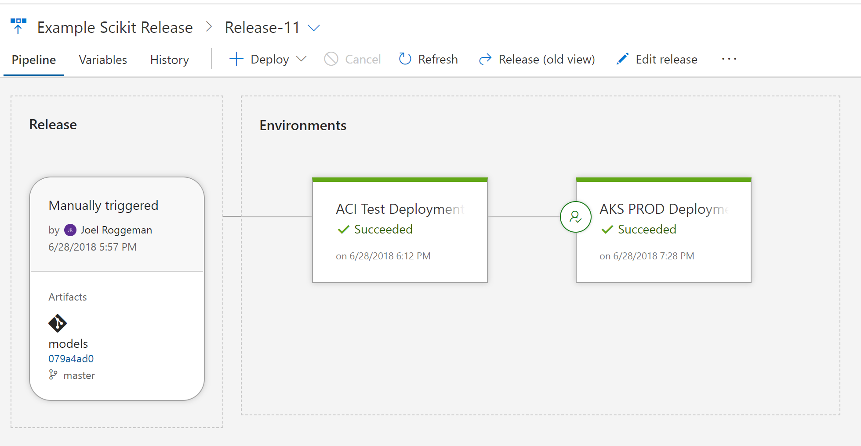
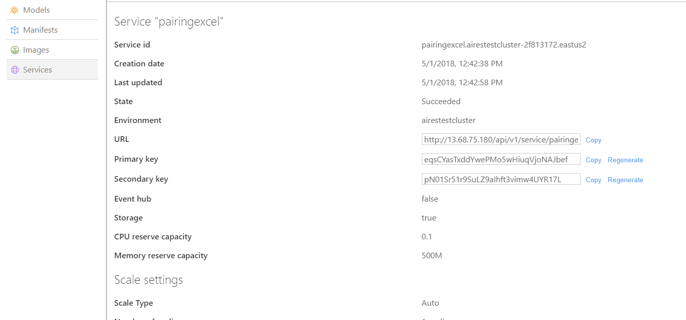
Model Deployment
Provide safe & efficient process to deploy models
Focus on ML, not DevOps
Get telemetry for service health and model behavior
Simplify process to interact with the model
code-generation
API specifications / interfaces
Support a variety of inferencing targets
Cloud Services
Mobile / Embedded Applications
Edge Devices
Quantize / optimize models for target platform
Control the rollout of your models (with A/B)
Compliant + Safe

Slide 38
Azure DevOps Pipelines

Slide 39

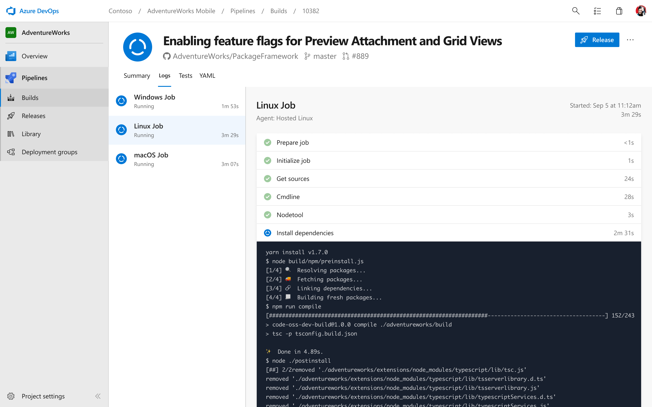


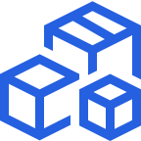
Azure DevOps Pipelines
Cloud-hosted pipelines for Linux, Windows and macOS.
Any language, any platform, any cloud
Build, test, and deploy Node.js, Python, Java, PHP, Ruby, C/C++, .NET, Android, and iOS apps. Run in parallel on Linux, macOS, and Windows. Deploy to Azure, AWS, GCP or on-premises
Extensible
Explore and implement a wide range of community-built build, test, and deployment tasks, along with hundreds of extensions from Slack to SonarCloud. Support for YAML, reporting and more
Containers and Kubernetes
Easily build and push images to container registries like Docker Hub and Azure Container Registry. Deploy containers to individual hosts or Kubernetes.

Slide 40
But I Don’t Work at a Big Company With
Thousands of ML Engineers!

Slide 41

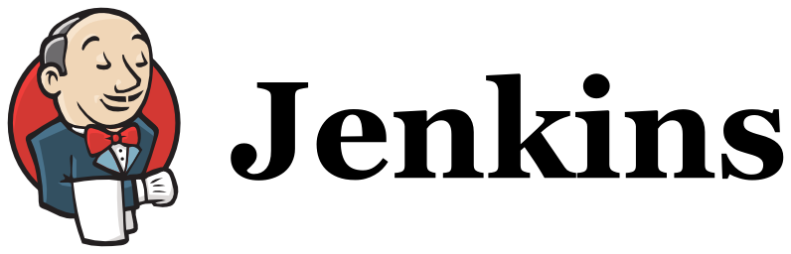
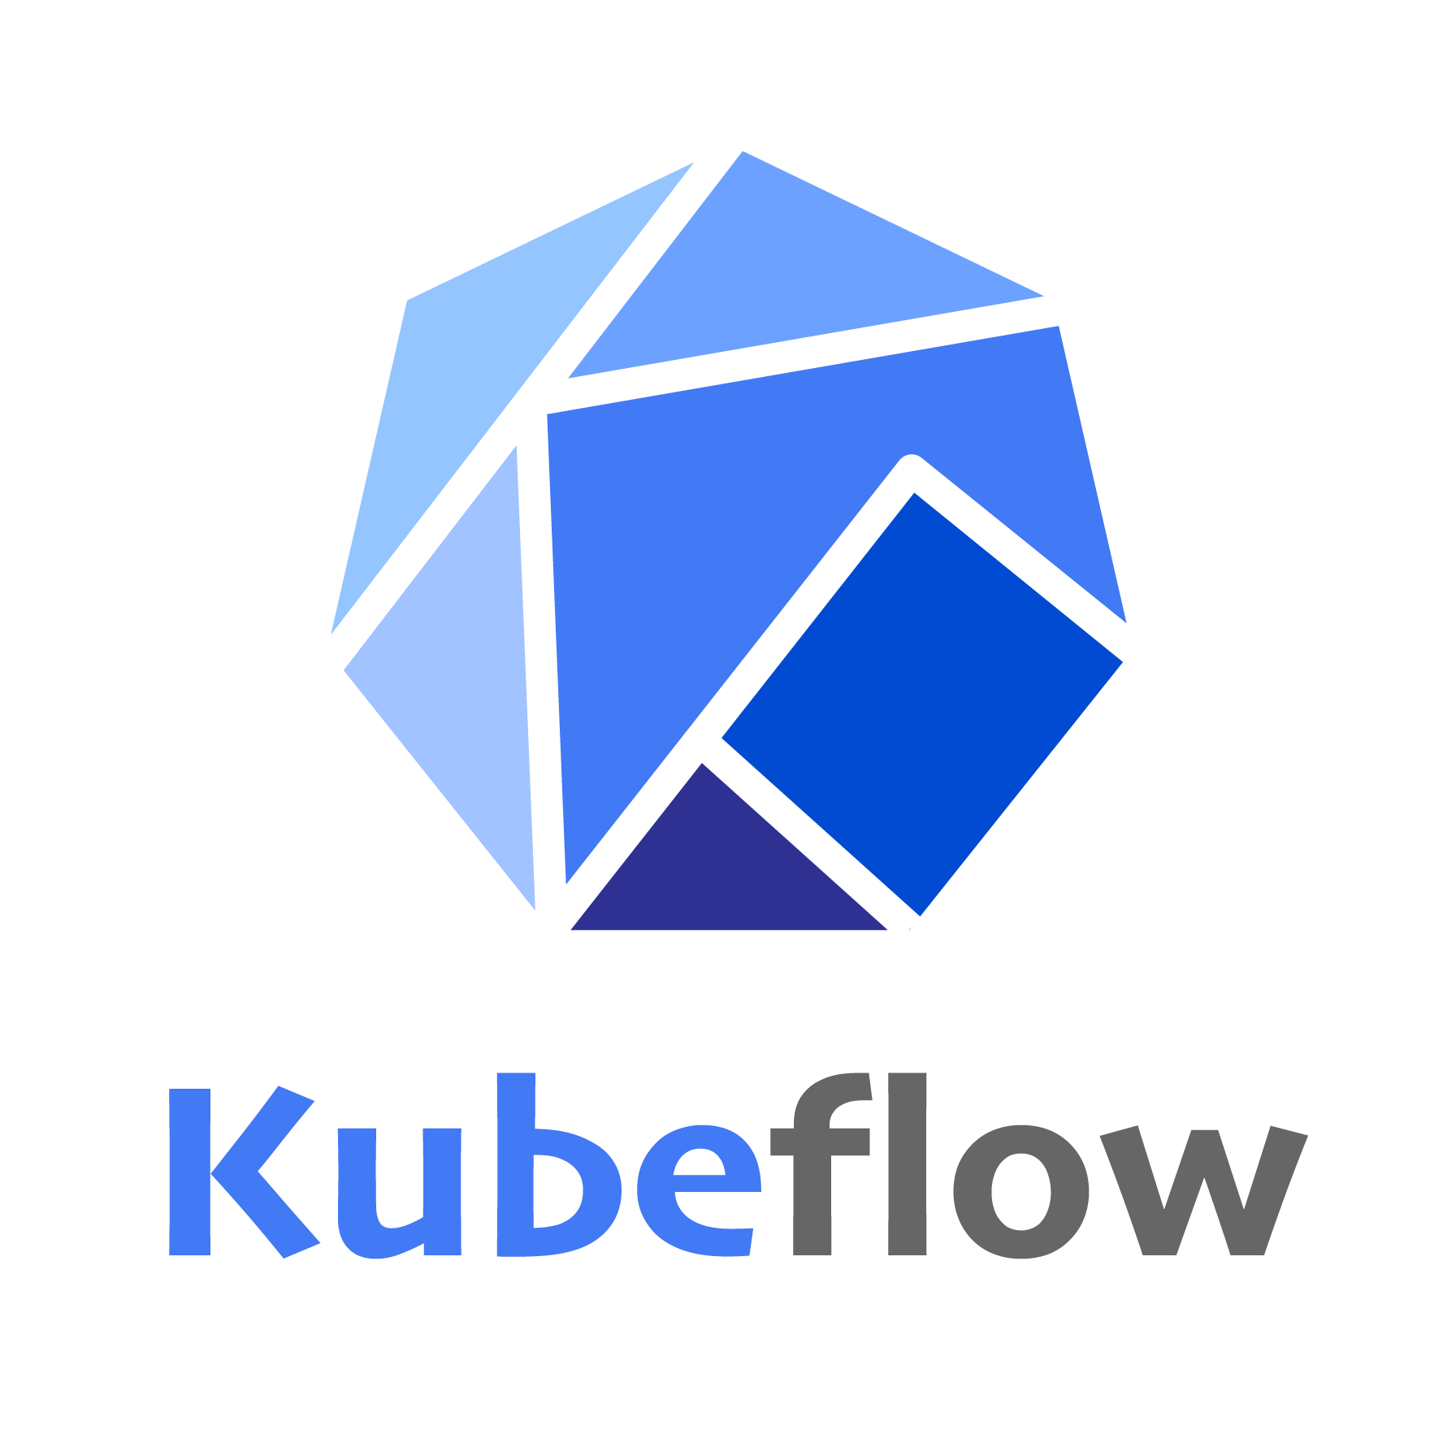



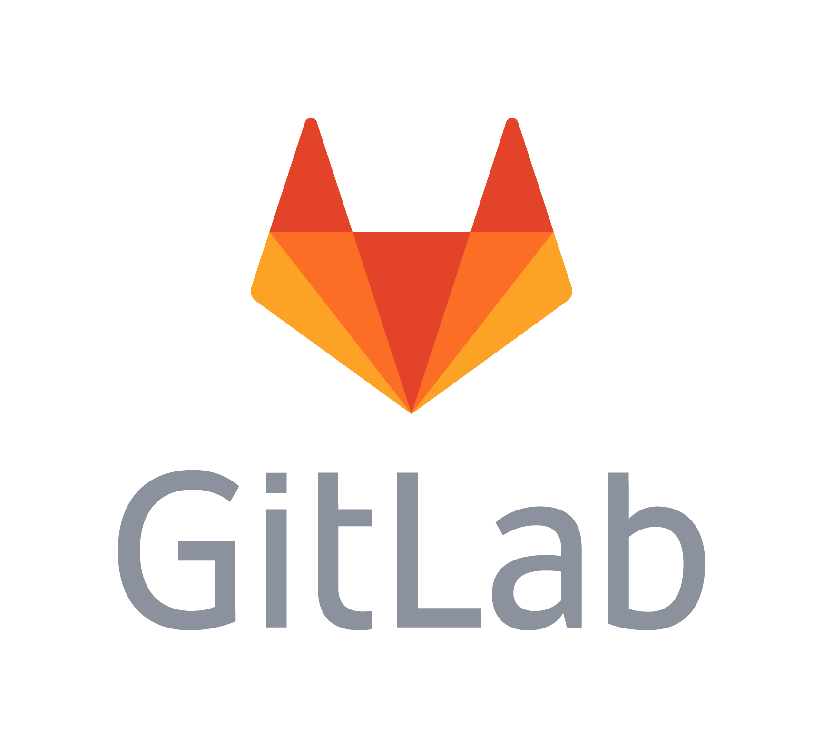
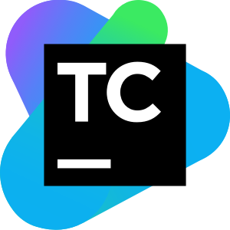
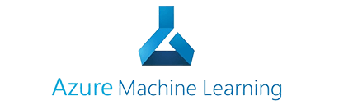



Build Your Own MLOps Platform
+
+
And many MANY more…
Notes:
27m-28m

Slide 42
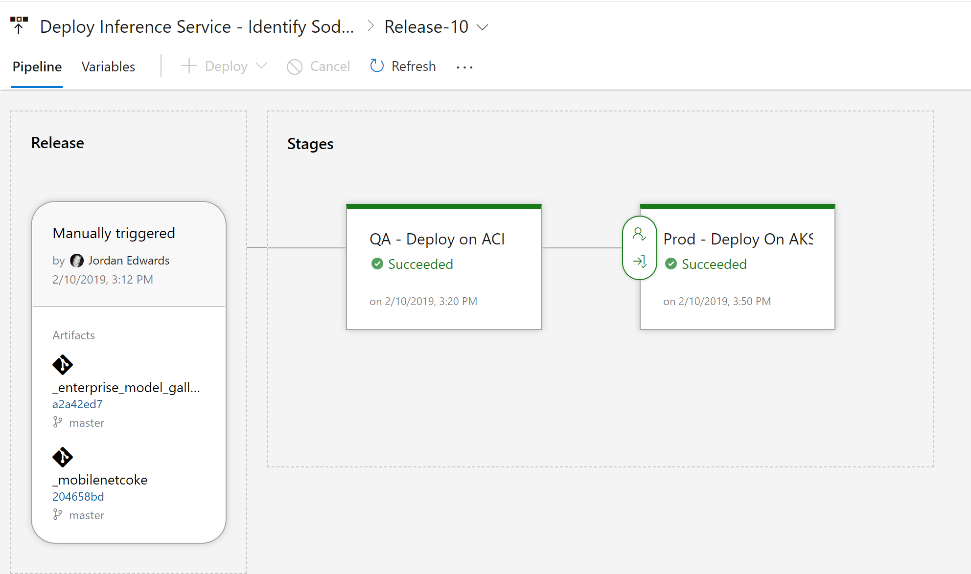
Azure DevOps + Azure ML
Trigger release pipelines on model registration
Use Azure DevOps + Azure ML CLI to manage E2E release flow
Leverage Azure DevOps approvals for controlling application rollout

Slide 43
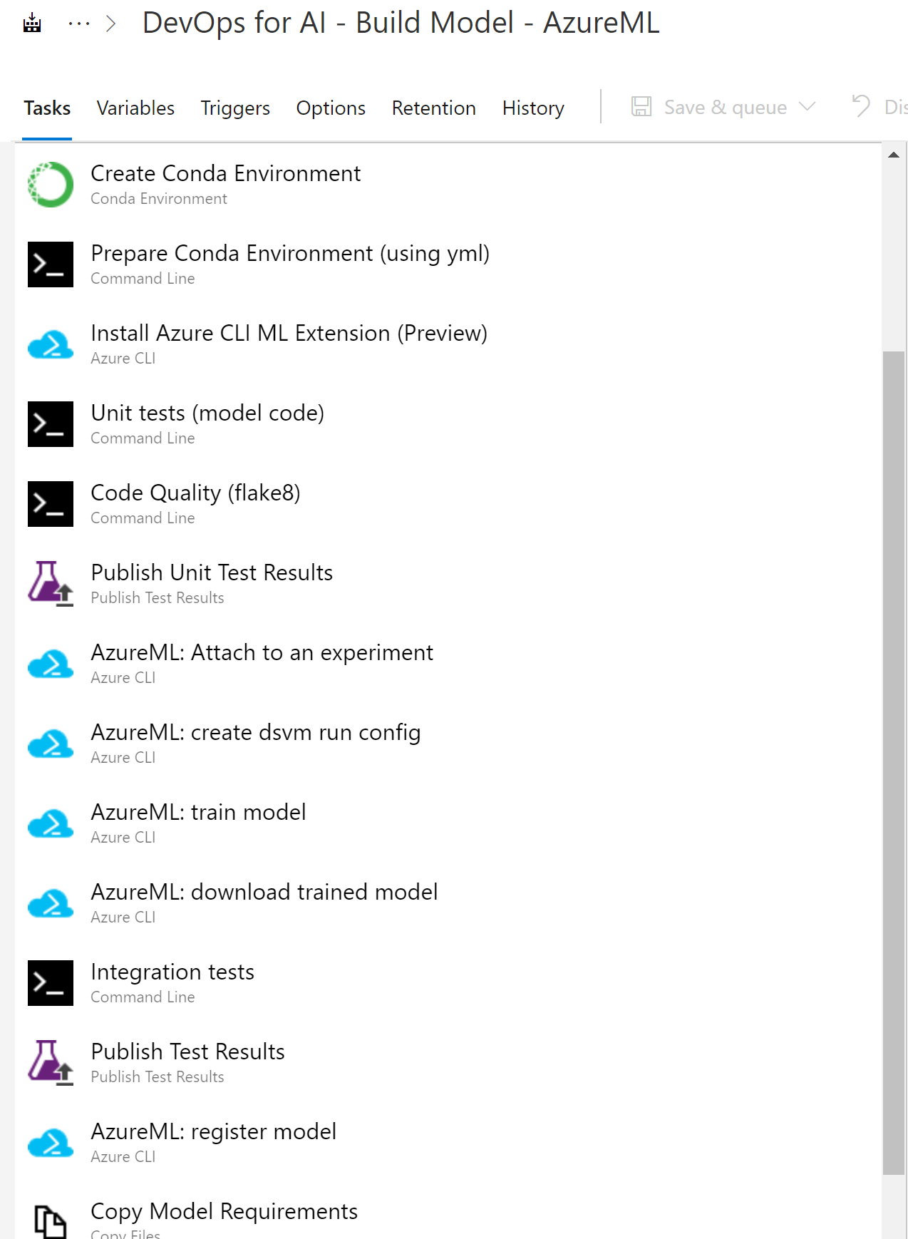
First Class Model Training Tasks
CI pipeline captures:
Create sandbox
Run unit tests and code quality checks
Attach to compute
Run training pipeline
Evaluate model
Register model

Slide 44
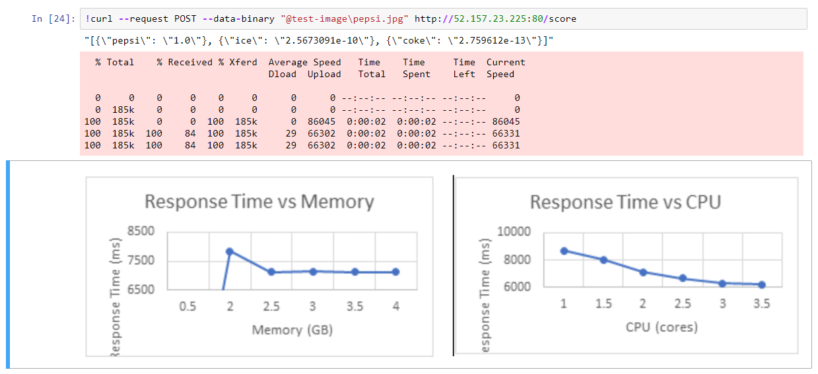
Gating and Provisioning on Validation & Profiling

Slide 45
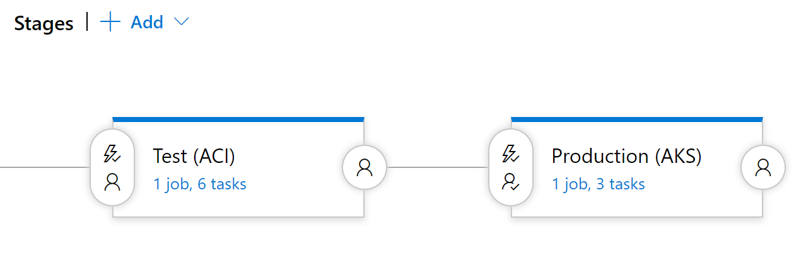
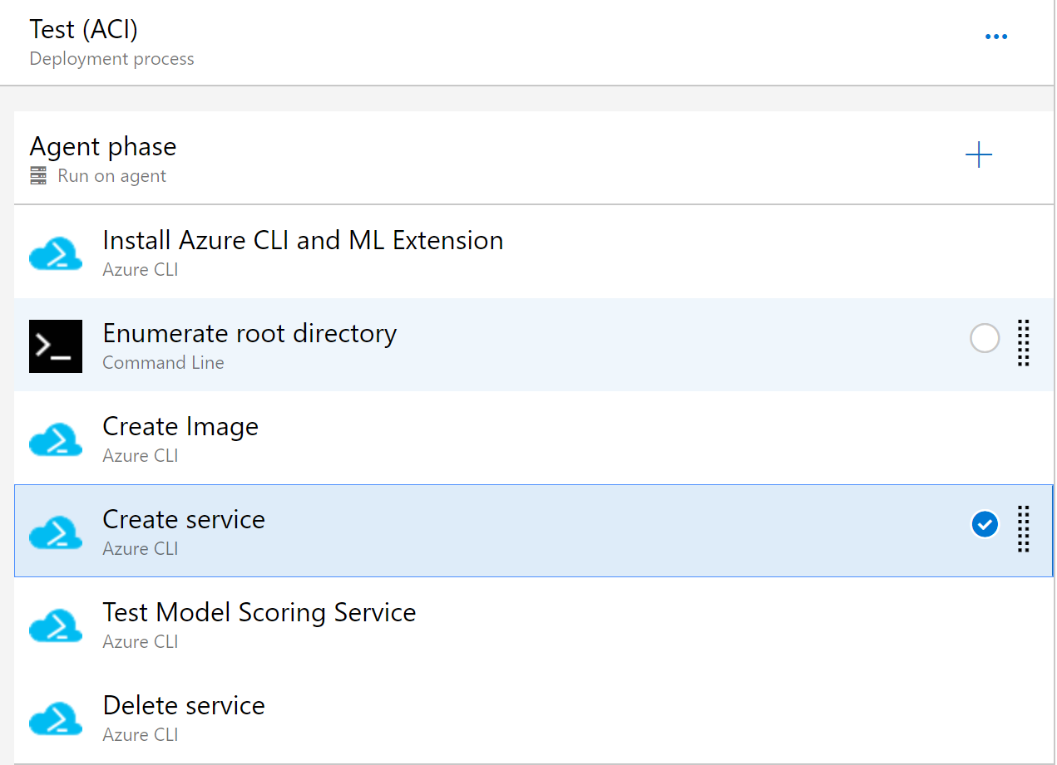
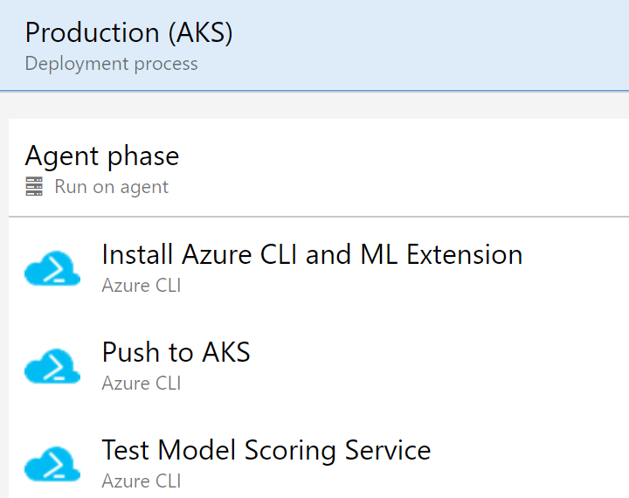
Automated Deployment
CD pipeline captures:
Package model into container image
Validate and profile model
Deploy model to DevTest (ACI)
If all is well, proceed to rollout to AKS
Everything is done via the CLI

Slide 46
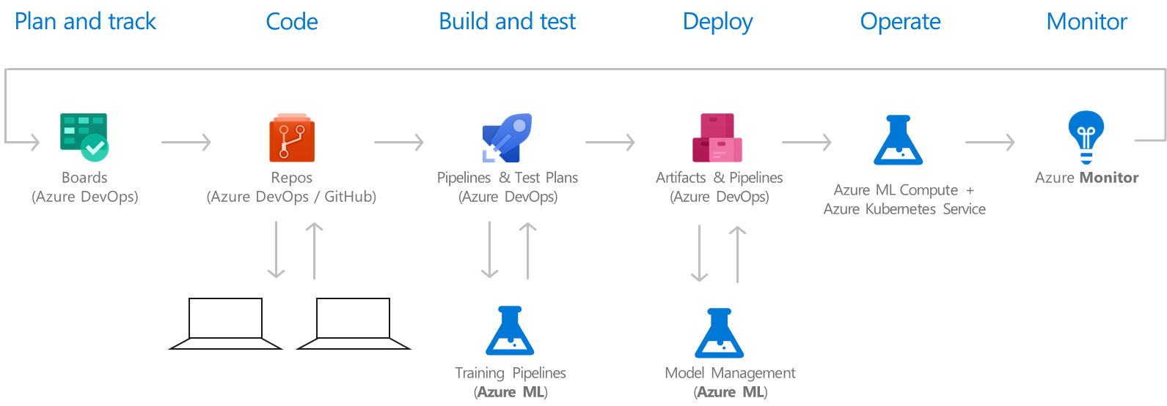
MLOps Framework on Azure

Slide 47
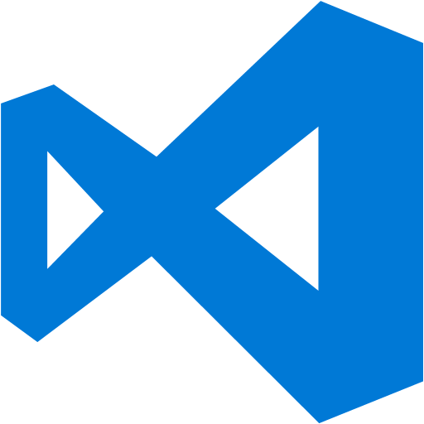




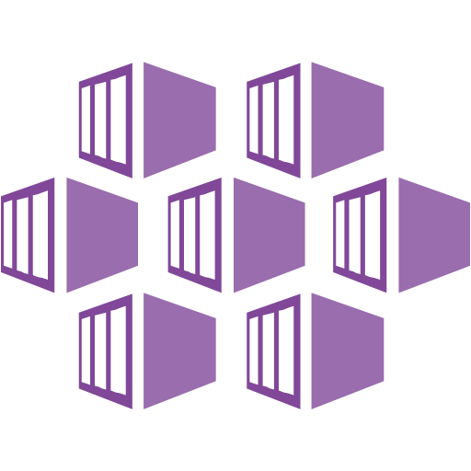


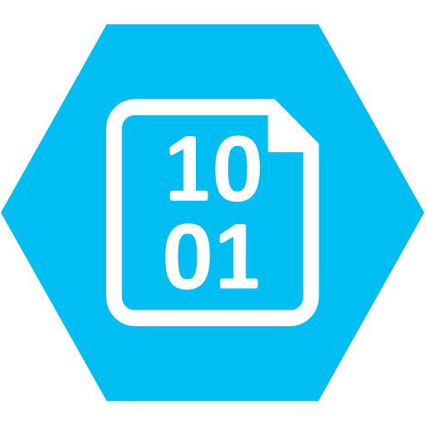



Azure ML Ops
Build Model (app) (testing + validation)
Deploy Model (app)
Azure DevOps
Deploy Resources
Management & Orchestration
Continuous Integration and Delivery
Integrate
ML Workspace
API Management
Data Factory
Serving
Real-Time
Azure Kubernetes Service
Experimentation
Register & Deploy
Docker + Conda Env.
Azure ML Experiments
Data Scientist
Batch
Azure ML Pipelines
Users
Compute
Logging & Monitoring
Data Engineer
Retrain
ML Compute
Databricks
Other ML Compute ..
Model / Data Monitoring
Deploy (IaC)
Storage
Data Collection
Application Performance Monitoring
DevOps

Slide 48
New Interaction with MLOps
Notes:
27m

Slide 49
Real World Multi-Cloud
Process
Train
Stage
Serve
Distributed Cloud
ENV #1
CI/CD Pipeline
Data Scientist
ENV #2
Data
SRE/ML Engineers
Notes:
29m-30m

Slide 50
Real World Multi-Cloud
Process
Train
Stage
Serve
Distributed Cloud
ENV #1
I need quick iteration and to train next to my data.
CI/CD Pipeline
Data Scientist
ENV #2
We need to handle production loads & be geo-distributed.
Data
SRE/ML Engineers
Notes:
30m-31m

Slide 51
Real World Multi-Cloud
Process
Train
Stage
Serve
Distributed Cloud
ENV #1
LET’S DO THIS!
CI/CD Pipeline
Data Scientist
ENV #2
LET’S DO THIS!
Data
SRE/ML Engineers
Notes:
31m

Slide 52
Real World Multi-Cloud
Process
Train
Stage
Serve
Distributed Cloud
ENV #1
First, I check in my code.
CI/CD Pipeline
Data Scientist
ENV #2
Data
SRE/ML Engineers
Notes:
31m

Slide 53
Real World Multi-Cloud
Process
Train
Stage
Serve
Distributed Cloud
ENV #1
That kicks off a CI/CD Pipeline.
CI/CD Pipeline
Data Scientist
ENV #2
Data
SRE/ML Engineers
Notes:
31m-32m

Slide 54
Real World Multi-Cloud
Process
Train
Stage
Serve
Distributed Cloud
ENV #1
CI/CD pipeline triggers a Kubeflow Pipeline on-prem
CI/CD Pipeline
Data Scientist
ENV #2
Data
SRE/ML Engineers
Notes:
31m-32m

Slide 55
Real World Multi-Cloud
Process
Train
Stage
Serve
Distributed Cloud
ENV #1
Process the data
CI/CD Pipeline
Data Scientist
ENV #2
Data
SRE/ML Engineers
Notes:
31m-32m

Slide 56
Real World Multi-Cloud
Process
Train
Stage
Serve
Distributed Cloud
ENV #1
And now do a training run on the processed data
CI/CD Pipeline
Data Scientist
ENV #2
Data
SRE/ML Engineers
Notes:
31m-32m

Slide 57
Real World Multi-Cloud
Process
Train
Stage
Serve
Distributed Cloud
ENV #1
When it’s done, it automatically registers the model!
CI/CD Pipeline
Data Scientist
ENV #2
Data
SRE/ML Engineers
Notes:
32m-33m

Slide 58
Real World Multi-Cloud
Process
Train
Stage
Serve
Distributed Cloud
ENV #1
CI/CD Pipeline
Data Scientist
ENV #2
Take the registered model and provision a staging endpoint.
Data
SRE/ML Engineers
Notes:
32m-33m

Slide 59
Real World Multi-Cloud
Process
Train
Stage
Serve
Distributed Cloud
ENV #1
CI/CD Pipeline
Data Scientist
ENV #2
Model integration works! Let’s roll out to production.
Data
SRE/ML Engineers
Notes:
32m-33m

Slide 60
Real World Multi-Cloud
Process
Train
Stage
Serve
Distributed Cloud
ENV #1
CI/CD Pipeline
Data Scientist
ENV #2
Trigger the CI/CD pipeline one last time.
Data
SRE/ML Engineers
Notes:
32m-33m

Slide 61
Real World Multi-Cloud
Process
Train
Stage
Serve
Distributed Cloud
ENV #1
CI/CD Pipeline
Data Scientist
ENV #2
And roll out to the world!
Data
SRE/ML Engineers
Notes:
32m-33m

Slide 62
Real World Multi-Cloud
Process
Train
Stage
Serve
Distributed Cloud
ENV #1
CI/CD Pipeline
Data Scientist
ENV #2
Data
SRE/ML Engineers
Notes:
33m-34m

Slide 63
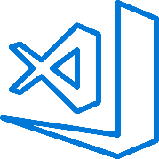
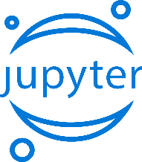

Train & Test Model
Azure MLOps Brings ML to Production
Register and Manage Model
Integrated with Azure DevOps
Build model (your favorite IDE)
Deploy Service
Monitor Model
Build Image
Notes:
Here is the data scientist’s inner loop of work
The interesting piece is now this DS loop is merged with the DevOps cycle
Offers complete ML lifecycle management
Brings CI/CD to life
Helps create the feedback loop for DS to improve
<Transition to BP discussion>
Let’s understand this better from the perspective of a customer

